Slide 1
Theme 4
AT SCHOOL
B. The library

Slide 2
GAME: JUMBLE WORDS
Liogoby
Torishy
Hispisc
Phygrageo
Luerateitr
Biology
History
Physics
Geography
Literature

Slide 3
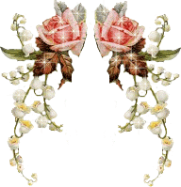
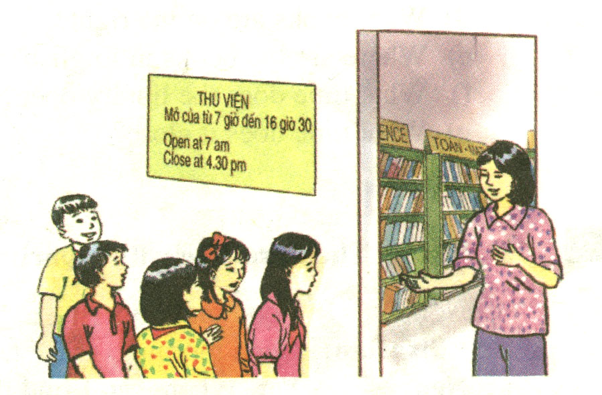
The library
UNIT 4

Slide 4
Grade 7
THEME 4: AT SCHOOL
B1: LISTEN AND READ
The library

Slide 5
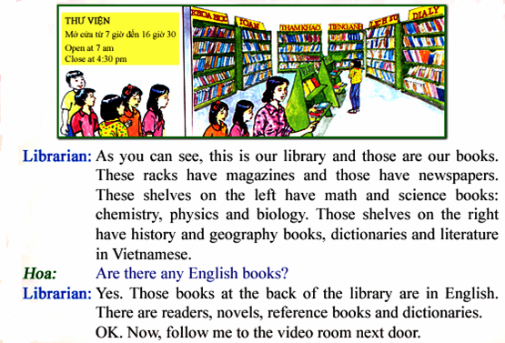
Listen and read.

Slide 6
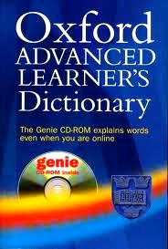
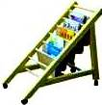
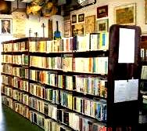
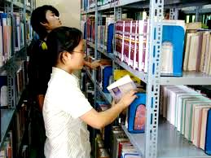
New words
1- library (n)/- librarian (n) :
thư viện / người thủ thư
2- rack (n):
giá đỡ
3- shelf (n)◻ shelves:
cái kệ
4- reader (n)
= reference book (n):
sách tham khảo
5- dictionary (n):
từ điển
6- novel (n):
tiểu thuyết
7- at the back (of):
ở phía cuối (của)
8- on the left (of)
ở bên trái (của)
9- on the right (of)
ở bên phải (của)
10- in the middle (of)
ở giữa (của)
stk

Slide 7
Checking words
rack (n)
library (n)
- librarian (n)
reader (n)
shelf (n)◻ shelves
novel (n)
dictionary (n)

Slide 8
* Matching:
Reference book (n) tìm thấy
Find(v) tiểu thuyết
Dictionary (n) giá đỡ
Novel (n) sách tham khảo
Rack (n) sách đọc thêm
/ đọc giả
Reader (n) từ điển
Library(n) thư viện

Slide 9
Read :
Librarian: As you can see ,this is our library and those are our books. These racks have magazines and those have newspapers. These shelves on the left have math and science books: chemistry, physics and biology. Those shelves on the right have history and geography books, dictionaries and literature in Vietnamese.
Hoa: Are there any English books?
Librarians: Yes. Those books at the back of the library are in English. There are readers , novel, reference books and dictionaries.
Ok. Now, follow me to the video room next door.

Slide 10
At the back
On the left
On the right
in the middle

Slide 11
Read and match the books with the places
1. magazines
2. Newspapers
3. Math and Science books
4. History, geography books, dictionaries and literature
5. English books
a. at the back of the library
b. in the middle of the library
c. on the shelf on the right
d. on the shelf on the left
e. on the racks
Key:
1. e
2. e
3. d
4. c
5.a

Slide 12
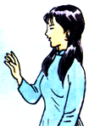
Answer the questions:
a) Where are the magazines?
b) Where are the newspapers?
c) What books are on the left?
d) What books are on the right?
e) Where are the books in English?
f) What time does the library open?
g) What time does it close?
Hoa
Librarian

Slide 13
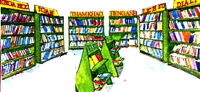
Answer the questions:
Math and science books
History, geography, dictionaries and literature
They are at the back of the library
The library opens at seven o'clock
b) Where are the newspapers?
c) What books are on the left?
f) What time does the library open?
a) Where are the magazines?
d) What books are on the right?
It closes at 4.30 pm
g) What time does it close?
They are on the rack
e) Where are the books in English?
They are on the rack
Hoa
Librarian

Slide 14
A2. Listen and Read
Nga: Good morning.
Librarian: Good morning. Can I help you?
Nga: Yes. Where can I find the math books, please?
Librarian: They’re on the shelves on the left.
Nga: Do you have magazines and newspapers here?
Librarian: Yes. They’re on the racks in the middle.
Nga: Thank you very much.
Librarian: You’re welcome.

Slide 15
Now ask and answer the questions: 1. Where are the magazines and newspapers? → They’re on the racks in the middle. 2. Where are the math books? → They’re on the shelves on the left. 3. What books are on the left? → The math books are on the left.

Slide 16
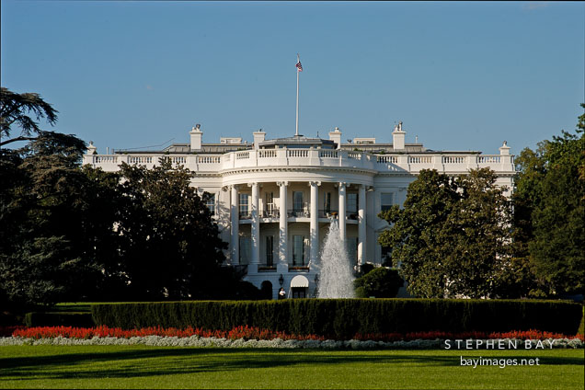
The White House. Washington, D.C., USA

Slide 17
I. Vocabulary
Congress (n)( The United
States of Congress)
Quốc Hội(Hoa Kỳ)
Capital(n)
thủ đô
receive (v)
nhận
copy (n)
bản sao
contain (v)
chứa
The White House. Washington, D.C., USA

Slide 18
Jumbled words
1. tianocn = ?
contain
2. pyoc = ?
copy
3. eicreve = ?
receive
4. plemoeey = ?
employee

Slide 19
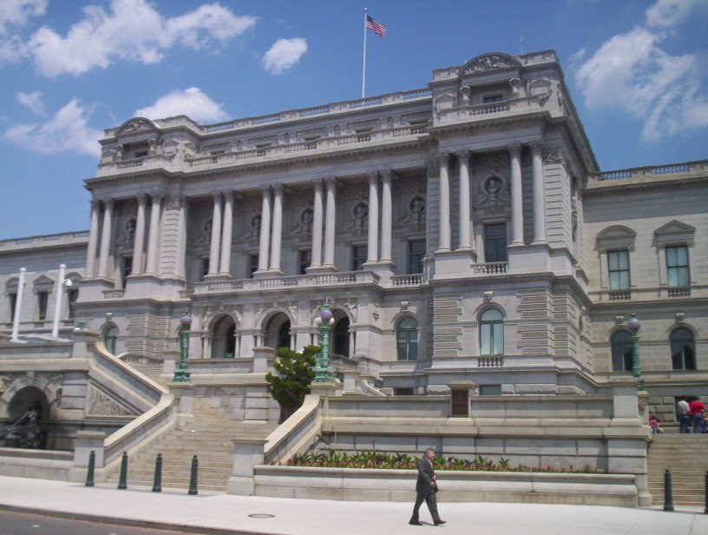
The Library of Congress

Slide 20
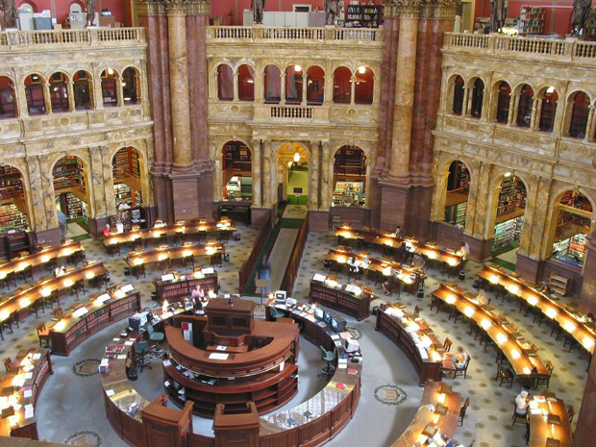
the reading room

Slide 21
The Library of Congress
One of the world’s largest libraries is the United State’s Library of Congress. It is in Washington D.C, the capital of the USA. It receives copies of all American books. It contains over 100 million books. It has about 1,000 km of shelves. It has over 5,000 employees.
True ( T ) or False ( F ) ?
The Library of Congress is in the capital of the USA.
T
b) The shelves are about 800 km long.
F
c) There are over 100 million books in this library.
T
d) It receives copies of all English books.
F

Slide 22
Read. Then answer :
Where is the Library of Congress?
How many books does it have?
How long are its shelves?
How many people work there?
Why is it so large?

Slide 23
ANSWERS:
a) Where is the Library of Congress?
- It’s in Washington D.C, the capital of the USA.
b) How many books does it have ?
- Over 100 million books.
c) How long are its shelves?
- About 1,000 km of shelves.
d) How many people work there?
- Over 5,000 people.
e) Why is it so large?
- Because it receives copies of all American books.

Slide 24
Practice:
Describe your school library.
* Use the prepositions of place :
- On / In / Behind / Next to
On the left / On the right
In the middle of
At the back of …

Slide 25
Homework
Learn by heart the new words.
Prepare Unit 5: Part A

